Slide 1
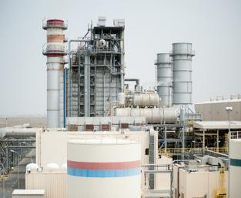
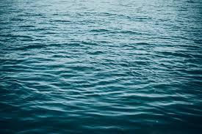
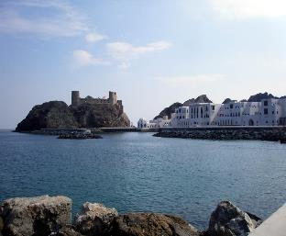
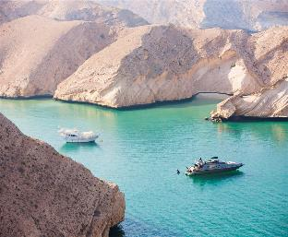
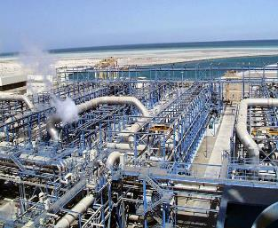
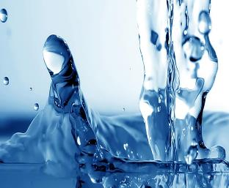
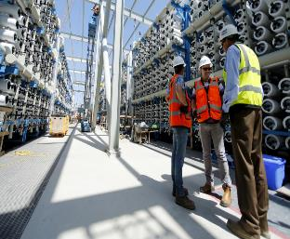
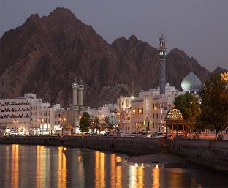
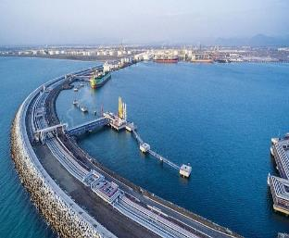
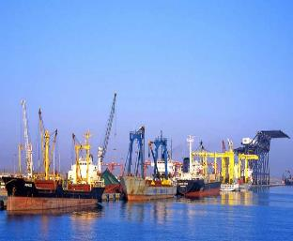
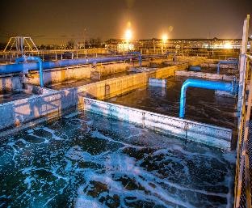
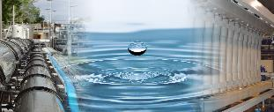
Majis at a Glance
Majis Industrial Services

Slide 2
Majis Snapshot
Established in 2006 and headquartered in Sohar, Oman’s largest industrial hub
Products and Services
Cooling Seawater
Capacity 734,000 m3/hr
Demand 585,000 m3/hr
Wastewater Treatment
Capacity 20,000 m3/day
Process Water
Capacity 20,000 m3/day
Potable Water
Capacity 11,000 m3/day
One-stop-shop for industrial water solutions in Oman
Footprint
Sohar Port
Sohar Freezone
Sohar Industrial City
Provides cooling
seawater, potable water,
pure process water
and irrigation water, as well as effluent treatment
Customers
All types of industries
Approx. 50 customers
~ 20+ year
Average Contract Tenure
Strategic relationship with Madayn to provide bulk water to Sohar Industrial City
Sole provider of uninterrupted and reliable water services to the Sohar Port & Freezone
New Opportunities
Salalah Free Zone
IWP
PPP - Misfah ISTP
Owned by OQ Group (100%)
Investments and JVs
51%
O&M JV – Oman Sustainable Water Solutions
(in partnership with FCC Aquila)

Slide 3
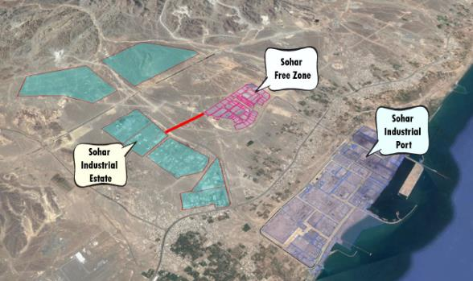
Current Footprint - Sohar
Majis operates in Sohar, one of the fastest growing Port and Freezone developments in Oman with concession agreement up to 2047 (Further extendable)
Sohar Free Zone
Sohar Industrial Port
Sohar Industrial City

Slide 4
Company Business Highlights
Robust Industry Dynamics and Operating Environment
1
2
Attractive Business Model
3
Modern and Well-Invested Assets
4
Defined Strategy for Sustained Growth Acceleration
5
Stable and Predictable Cash Flows Delivering Attractive Growth
Capable and Experienced Management
6

Slide 5
1
Business Growth
Opportunity to Tap in Other Freezones
Target other freezones in Oman to provide utility solutions
Sohar Industrial Estate
Free Zones
Al Buraimi Industrial Estate
Sohar Port & Freezone | Steel, trade & logistics, oil and gas, petrochem
Salalah Free Zone | Industrial, manufacturing, R&D, logistics
The Port of Sohar
Freezone Sohar
Knowledge Oasis Muscat
Rusayl Industrial Estate
Industrial Cities - Madayen
Rusail | Chemicals, fiber optics, food processing, garment, paint
Sohar | Marble, paper, food, chemicals, glass & steel, engine oils
Raysut | Stationary, food processing, medical, solar, fertilizers
Sur | Natural gas, fisheries, fertilizers
Nizwa | Ceramics, plastics, plywood, mineral water
Al Buraimi | Paints, plastic, wood, oil & gas, pharma, iron, steel
Samail | General industrial activities
Knowledge Oasis Muscat | Information technology services
Al Mazunah | Warehousing, logistics, food
Sumail Industrial Estate
Nizwa Industrial Estate
Salalah Free Zone
Duqm
Al Muzanah Free Zone
Salalah Airport
Raysut Industrial Estate
Port of Salalah

Slide 6













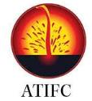



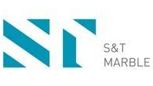

2
Competitive advantages of Majis
Stable and High Growth Business Model
✓
Exclusive concession in the Sohar Freezone and sole provider of seawater intake at the Port of Sohar
✓
Ownership of integrated utility assets, i.e. Sea water intakes, RO plant, CETRP, network etc.
✓
Ability to scale and grow the business being an independent integrated utility provide (i.e. not an IWPP with a single asset)
✓
Long-term (20+ year) contracts with blue chip customers in Sohar
✓
Strong financial position and very stable cash flow
✓
Unregulated tariffs
Key customers – Sohar Port
Key customers – Sohar Freezone
Prospective customers
Salalah Free Zone
Maadayn
PPPs

Slide 7
3
Attractive Business Model
Captive Customer Base, Long-Term Contracts, Take-or-Pay Agreements
✓
Long Contract Tenure
Long-term contracts with customers that have an average remaining duration of 15+ years
% of Contract Value
✓
Over ~ 90% of the water supply contracts are take-or-pay agreements
✓
Client base is spread across eight industries catering to the wider Sohar Port & Freezone area
✓
Captive customer base through exclusive concession right in Sohar Freezone
Stable Revenues
Remaining period for contracts (years)
Predictable Cash Flows
Minimised Market Risk
An uninterrupted supply of water services to meet specific customer needs

Slide 8
4
Stable and Predictable Cash Flows
Proven Track Record of Delivering Growth
Reporting continued growing profit
20.14% CAGR
FY10 – FY21
Robust rate of growth that has shown resilience to economic cycles

Slide 9
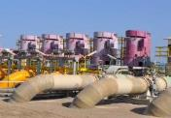

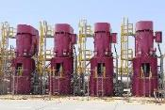
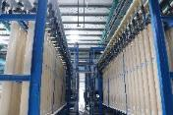


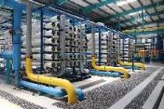


5
Modern and Well-Invested Assets
Ownership of Plants and Various Water Distribution Networks
Asset
Service
Capacity
Networks
SWIPS - 1
Chlorinated seawater
334,000 m3/hr
Common Cooling Water
Capacity 60,000 m3/hr
Length: 16 km
No. pumps: 4 pumps
SWIPS - 2
SWIPS - 2
Chlorinated seawater
400,000 m3/hr
RO Plant
RO Plant
Potable and processed water
Capacity: 40,000 m3/day
Length: 24 km
No. pumps: 6 pumps
20,000 m3/day
Process Water
Potable Water
Capacity: 26,000 m3/day
Length: 59 km
No. pumps: 5 pumps
10,000 m3/day
10,000 m3/day
Treated Industrial Effluent
Domestic Sewage Discharge
Irrigation Water Network
CETRP Phase I
CETRP Phase II
Collect, treat and recycle industrial effluent and domestic wastewater
Capacity: 20,000 m3/day
Length: 13 km
Capacity: 3,000 m3/day
Length: 30 km
Capacity: 4,000 m3/day
Length: 9 km

Slide 10
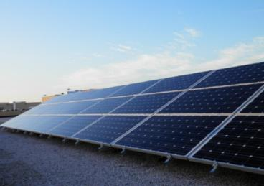
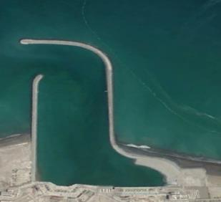
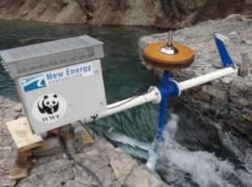
6
Defined Strategy for Sustainability
Reducing Operating Costs & Environmental Footprint
Solar Power
1.3 MWp Solar PV System at Sohar Port
Generating 2,350 MWhr annually.
Reduces CO2 emission annually by 1,400 tonnes
Equivalent to planting 57,000 trees
Gas savings 1 million m3 per year
Commenced operation in 2021
Floating Solar from Intake
Targeted capacity 15MW
Target to reduce 30% use of national grid
Business model under preparation.
Targeted time to commence 2025
Hydro Power
First Hydropower in the GCC
Purpose is to provide green source of energy as well as reducing the temperature of the return water
Targeted production of 2.7 MW from the return water to the sea
Targeted time to commence 2024

Slide 11
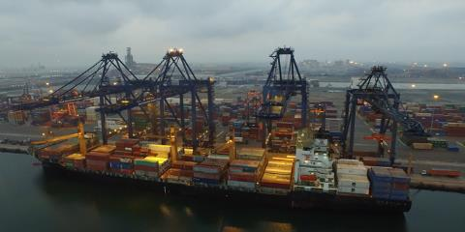
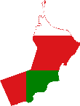
7
Defined Strategy for Growth Acceleration
Build on Established Position, Penetrate New Markets
A
Grow at Sohar
B
Penetrate Oman
C
Expand into the region
Increased uptake from existing capacity as a result of :
New industries launching in the Sohar area
Expansion of Sohar Port
Development of Sohar Freezone
Services to new industrial areas in Sohar
Optimized costs as a result of:
Minimal maintenance required for recently commissioned assets
Economic development in Oman could trigger water supply opportunities such as:
Development of Salalah Free Zone
Madayn Industrial Cities across Oman
Joint bids for various PPP across Oman
Potential waste treatment opportunities including:
Collaboration with Bee’ah to divert waste treatment requests to Majis
Development of biological solid waste
Building a strong and geographically diverse capacity
Growth in the region

Slide 12
7
Defined Strategy for Growth Acceleration
Ongoing Opportunities for Revenue Growth
1
Purpose: Sign Agreements for Provision of full scale water solutions to other industrial areas and Free Zones in Sultanate of Oman
Expected Timing: 2024
Industrial Cities and Free Zones in Oman
2
Independent Water and Wastewater Plants
Purpose: Participation in bids for construction and O&M of independent water and wastewater plants in Sultanate of Oman - PPP
2
Joint bids
Purpose: Jointly bid on individual projects in Oman and GCC.

Slide 13
End

